Slide 1



How Including a Clean Fuel Standard in the FY 2025 NYS Budget Would Accelerate Electrification, Improve Air Quality, and Ensure that New York’s ZEV Mandates are Achievable
Tuesday, December 19, 2023

Slide 2
Attendees
Julie Tighe, Patrick McClellan, Andrew Williams – NYLCV
Bertha Lewis – The Black Institute
Tunisha Walker-Miller – The Source Consulting Group
Rich Kassel – AJW, Inc.
Floyd Vergara – Clean Fuels Alliance America
Michael Trunzo – Shenker Russo & Clark

Slide 3
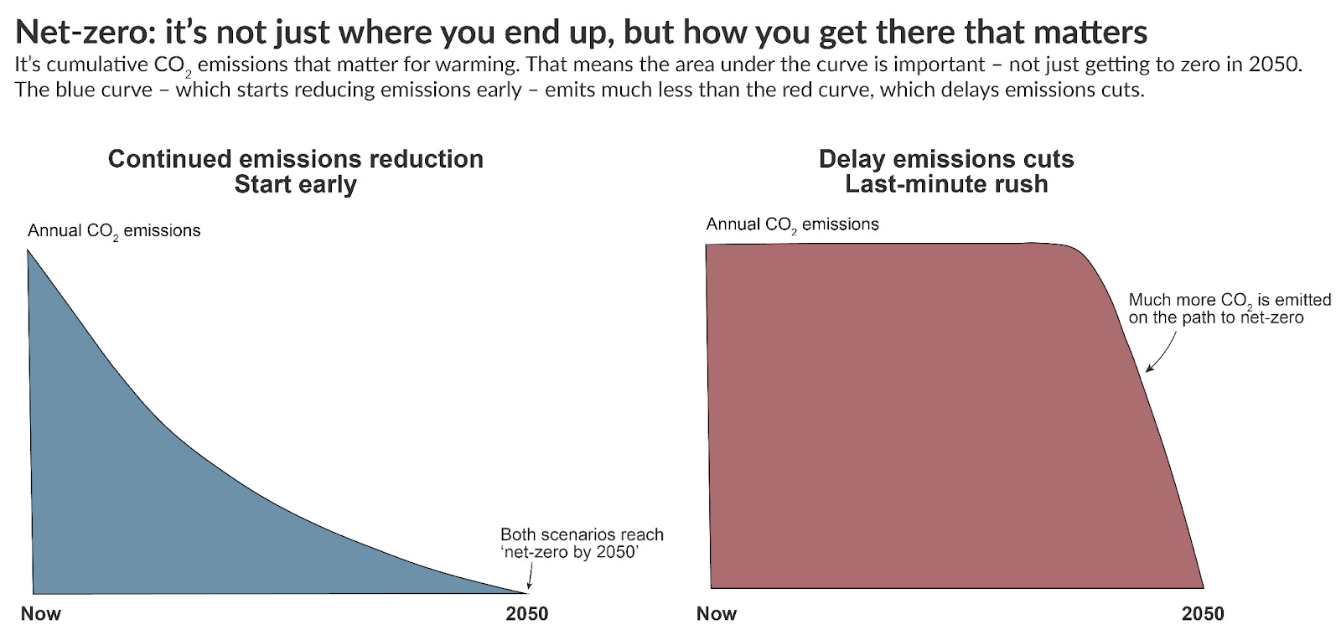
What We Do Between Now And 2040 REALLY Matters - For Both Climate and Health!

Slide 4
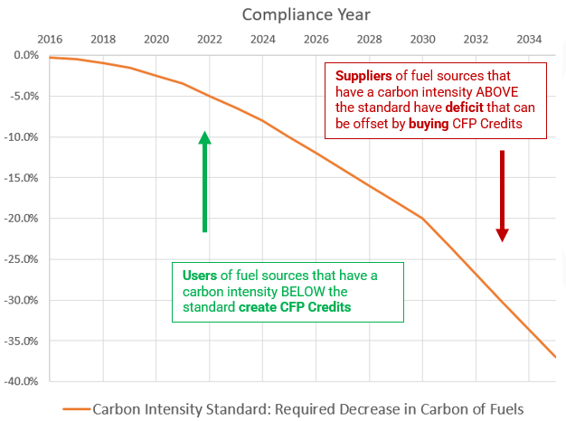
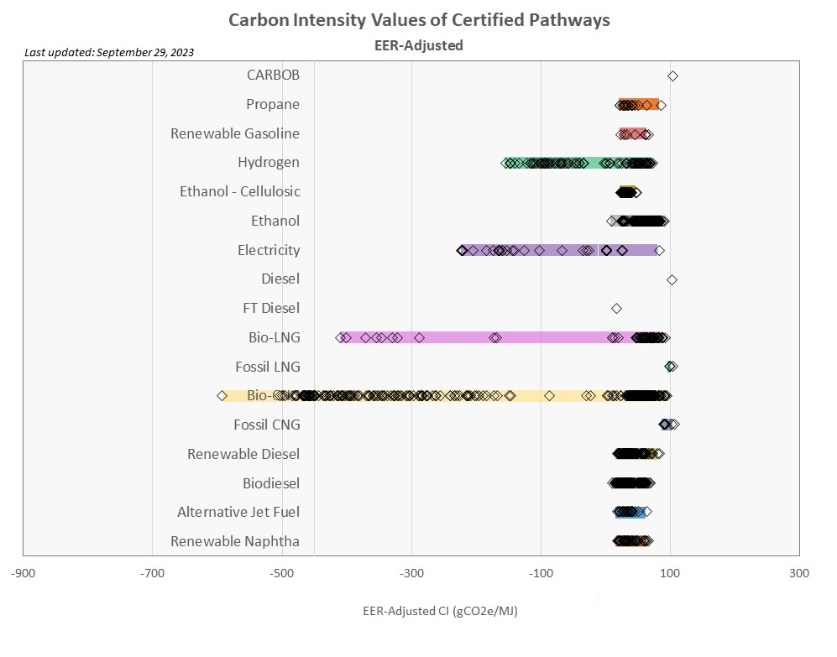
How Does a CFS work?
Recommended as “Clean Transportation Standard” in the CLCPA Scoping Plan. Based on CA, OR, and WA Low-Carbon Fuel Standard programs, refined to meet New York’s needs

Slide 5
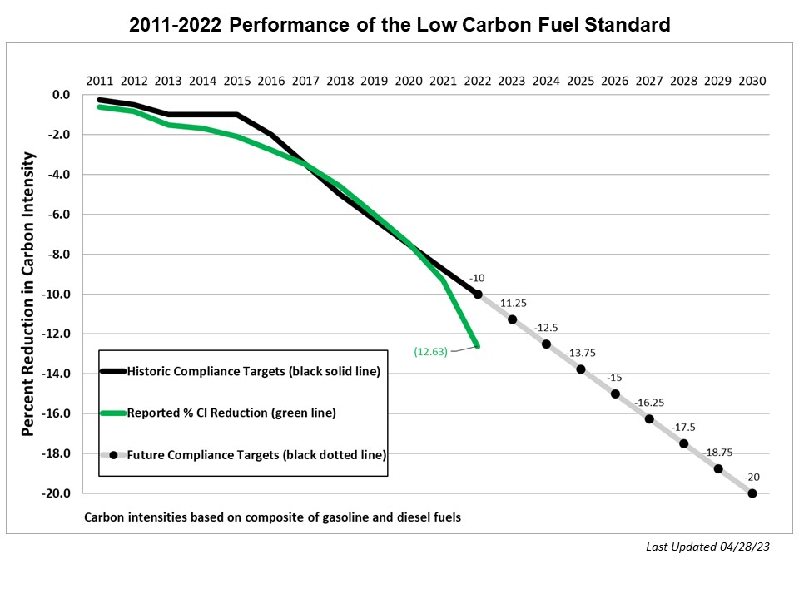
California’s LCFS is Decarbonizing Transportation Ahead of Schedule
Key points:
21% of California car market is now ZEV – compared to 9% of US market
CA accounts for 39% of all EV registrations in the US; NY just 4%
57% of California’s diesel pool is now bio-based – NOT petroleum!
Diesel PM has been reduced 3x as much in California’s “High-Risk” communities as in the state’s “Low-Risk communities, - thanks to accelerated retirement of “dirty diesels”
CARB now considering a 90x45 goal
  Sources: CA Office of Environmental Health Hazard Assessment, May 2022; CARB LCFS Data Dashboard

Slide 6
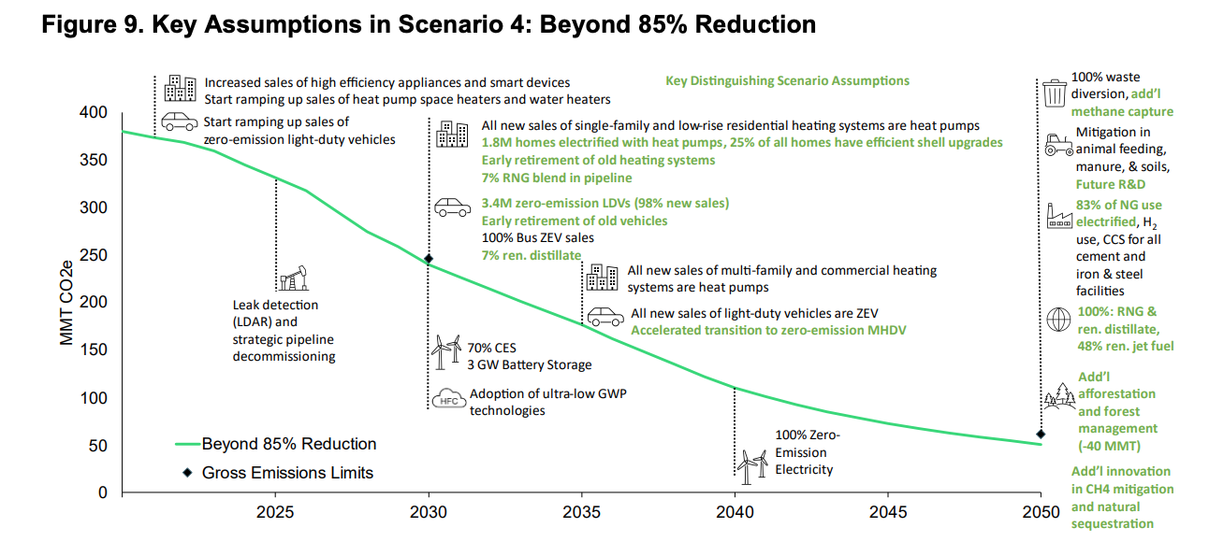
CFS with Aggressive Electrification Produces Greatest Emission Reductions
CLCPA Scoping Plan, p. 122

Slide 7
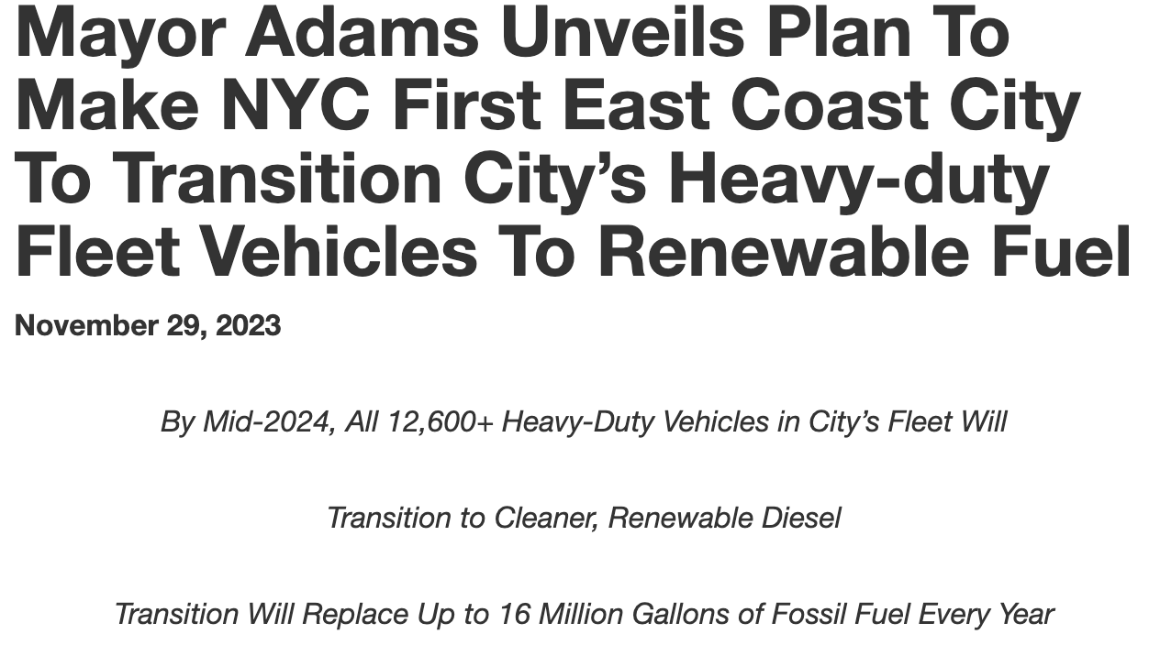
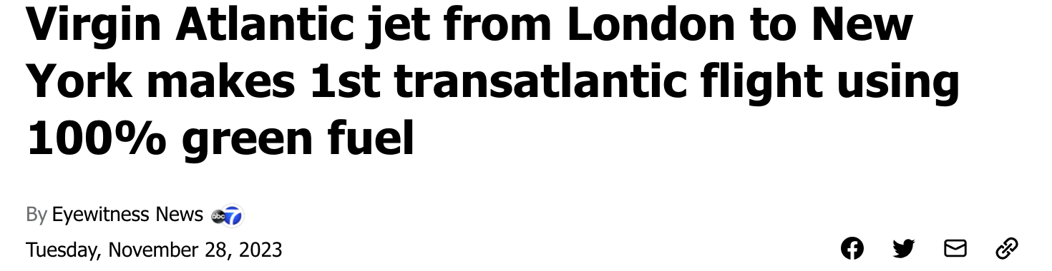
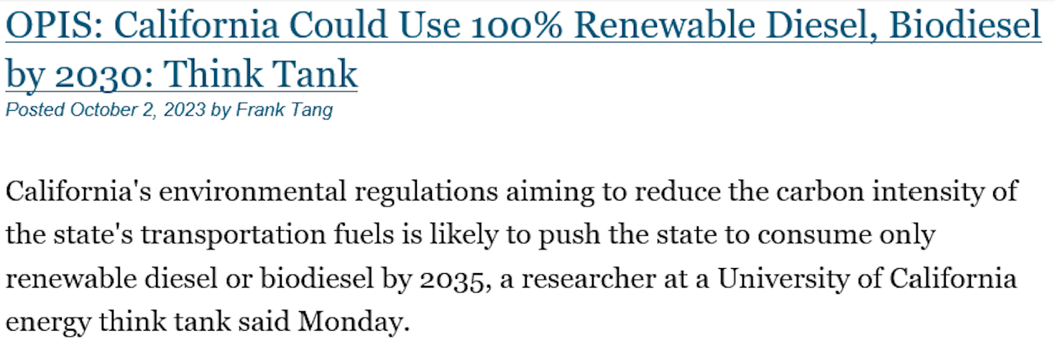
Cities, Fleets, and even Airlines are Moving to Clean Fuels

Slide 8
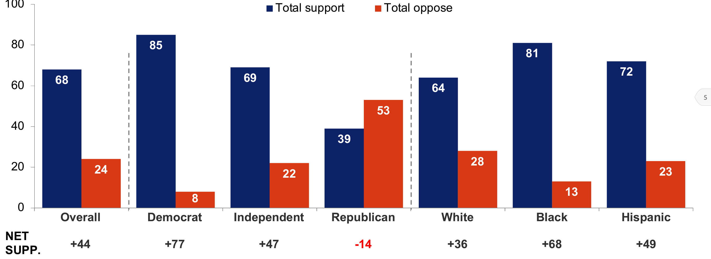
A Clean Fuel Standard is Politically Popular
  Over two-thirds (68%) of New York voters support a clean fuel standard while less than a quarter (24%) oppose it. Majorities of voters across all major demographic subgroups support a clean fuel standard, with 81% of Black voters and 72% of Latino voters in support.
These findings are based on the results of a text-to-web and online survey in New York among N=800 registered voters statewide plus an additional N=100 Black voters and N=100 Latino voters, conducted by Impact Research between February 22-28, 2023. The confidence interval for the overall sample is ± 3.5 at the 95% level of confidence.

Slide 9
New York’s CFS Bill
S. 1292 (Parker) passed the Senate 51-11 with no floor debate
A. 964 (Woerner) has 96 co-sponsors
Included in the Caucus’ 2024 People’s Budget
New York’s bill would:
  Require a 30% reduction in carbon intensity over 10 years
  Use Argonne-GREET accounting with a 20-year GWP
  Require utilities and State agencies and authorities to invest at least 40% of the credits they accrue in electrification projects in disadvantaged communities
  Allow aviation fuel to opt-in to the program

Slide 10
C&T and LCFS Are Complementary policies
  “CARB designed the LCFS and Cap-and-Trade Programs to complement one another.”
  “Investments made to comply with one…will generally result in reduced compliance requirements for the other…”
  “Increased use of low-carbon fuel due to the LCFS will reduce fuel suppliers’ GHG emissions covered by the Cap-and-Trade Program, reducing the Cap-and-Trade Program compliance obligation…”
  “Similarly, selling cleaner fuels or investing in emission reduction projects at California refineries and oil fields to comply with the Cap-and-Trade Program may also generate credits under the LCFS.
Source: CARB, Standardized Regulatory Impacts Assessment (SRIA), 2023 LCFS Amendments, https://ww2.arb.ca.gov/sites/default/files/2023-09/lcfs_sria_2023_0.pdf, at 30.

Slide 11
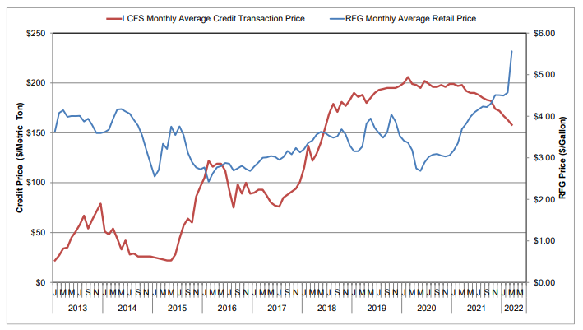
No Correlation Between LCFS Credit and Retail Pump Prices
Correlation coefficient = 0.06

Slide 12
Additional Slides

Slide 13
Key Attributes of a Clean Fuel Standard
Technology-neutral and fuel-neutral program for all transportation energy, including all fuels and electricity
Covers refiners, blenders, importers, distributors, and generators of fuel/electricity used in transportation
Program credits/deficits are based on direct and indirect lifecycle GHG emissions
  Only fuels with net health benefits generate credits
Declining annual cap means that today’s marginally better fuels can become deficit generators in the future

Slide 14
How does a CFS fit in with other CLCPA/clean air goals?
Complements Cap-and-Invest by targeting emission reductions into the transportation sector
Dedicates >40% of utility/state agency/authority revenue electrification and diesel pollution reduction in the State’s Disadvantaged Communities
Funds for electrification and decarbonization from fossil fuels – not ratepayers!
  Will generate >$1.3B/year - without further NYS budget action
Creates a revenue stream to help ensure transit and school bus fleets electrify on schedule
Reduces PM, NOx, and other air toxics to help NYS meet its Clean Air Act requirements
Reducing petroleum use in trucks and buses will generate >$1B in cumulative health benefits by 2030
Will create 9,200 jobs and $2.6B/year in wage income
Without a CFS, under DEC’s most ambitious “electrify everything” scenario (98% of car sales and 40-50% of truck sales are ZEV by 2030), roughly 1/3 of transportation energy in 2050 will still be fossil fuels, thanks to legacy vehicles and non-ZEV vehicles still to be sold

Slide 15

Study Shows Significant Health Benefits from B100
Switching to B100 in legacy vehicles and heating would:
For New York (4 sites – Port Elizabeth, the Bronx, Albany, Buffalo)
  Prevent 203 premature deaths/yr
  Result in 36,600 fewer sick days/yr
  Reduce 88,700 asthma cases/yr
  Avoid $1.7 billion/yr in health costs
For all 28 sites
  Cancer cases reduced by nearly 9500 (over 70-yr timeframe)
  Nearly 930 fewer premature deaths/yr
  Over 456,000 fewer/reduced asthma cases/yr
  Over 142,000 fewer sick days/yr
  Nearly 829,000 fewer minor restricted activity days/yr
  $7.5 billion in avoided health costs/yr
  Source: Trinity Consulting, https://cleanfuels.org/sustainable-impact/health-benefits-study/

Slide 16
The table below presents emissions results compiled from several significant studies assessing the impact of utilizing 100% renewable diesel.
Study Description | Emissions vs. Petroleum Diesel
 | PM | NOx | CO
California Air Resources Board (CARB). “Biodiesel Characterization and NOx Mitigation Study.” 2011. | -28% | -14% | -14%
Khan, et al. “Impact of Algae Biofuel on In-Use Gaseous and Particulate Emissions from a Marine Vessel.” 2012. Note: Study focused on 50% blends of RD and petroleum diesel, so the figures likely understate emissions benefits. | -25% | -10% | -18%
CARB. “Multimedia Evaluation.” 2015. | -30% | -10% | -5 to -10%
Gladstein and Associates for South Coast Air Quality Management District and Bay Area Air Quality Management District. “Renewable Diesel as a Major Transportation Fuel in California.” 2017. | -29% | -13% | NA
Southwest Research Institute for CARB. “Renewable Diesel Effects on Exhaust Emissions from a Tier 3 GE ES44C4 Locomotive.” 2021. | -33% | -14% | -17%
University of California-Riverside for CARB. “Low Emission Diesel Study.” 2021. | -32% | -3% | -17%

Slide 17
B100 health benefits: Port Elizabeth, ny/nj
Cancer Burden Pre/Post-Switch to B100 (Up to 2516 fewer cases)
-cleanfuels.org

Slide 18
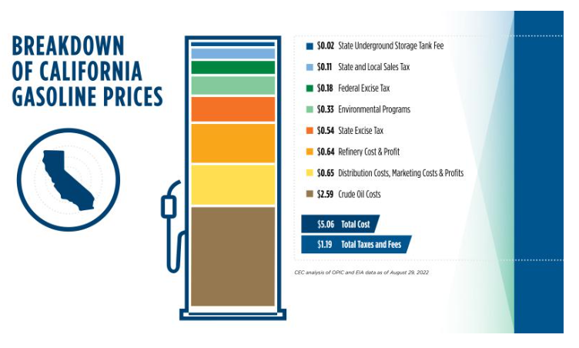
  LCFS ~2.1% of gasoline pump price (11 cpg)
  C&T ~ 4.3% of gasoline pump price (22 cpg)
  LCFS + C&T less than 6.5% of pump price
  Taxes, crude oil, refining, profits = 93.5% of pump price (crude oil alone is 51%)
  Source: CA Energy Commission, https://www.energy.ca.gov/data-reports/energy-insights/what-drives-californias-gasoline-prices

